Slide 1

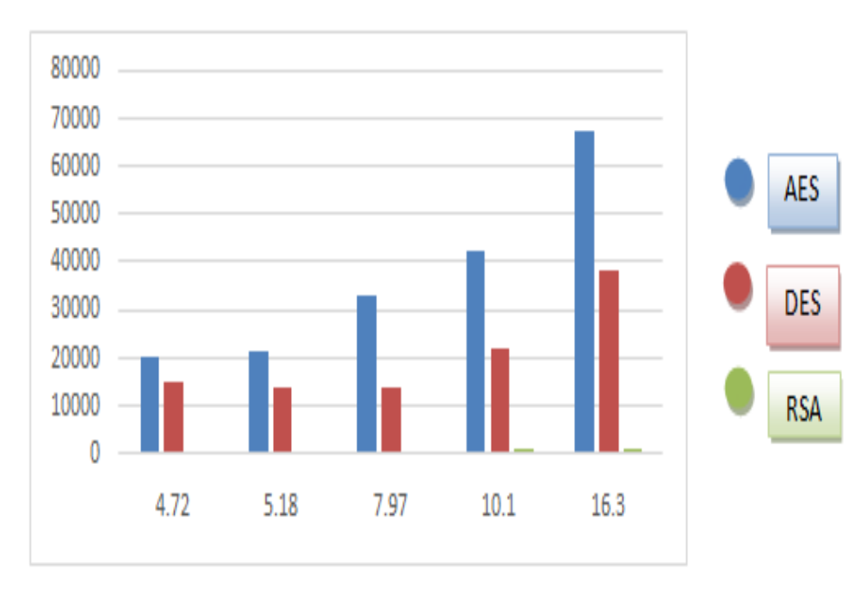
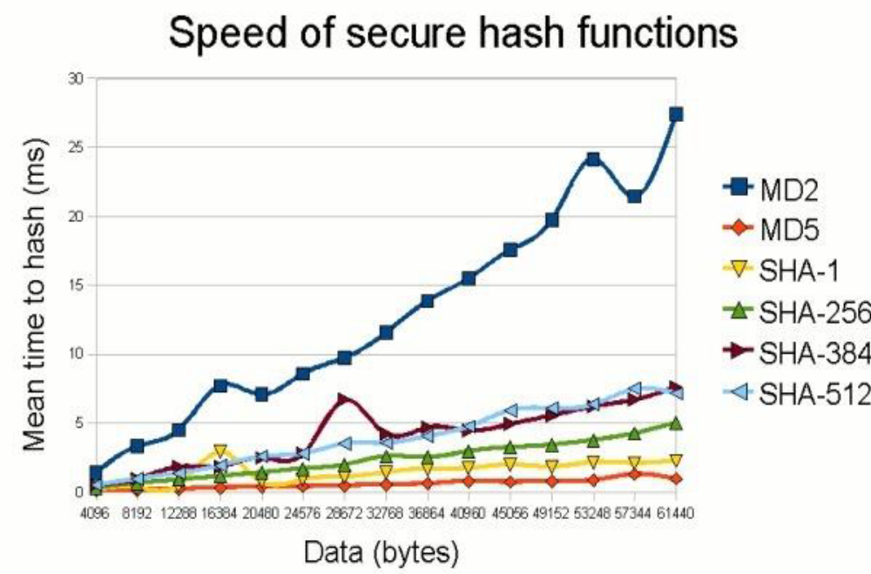
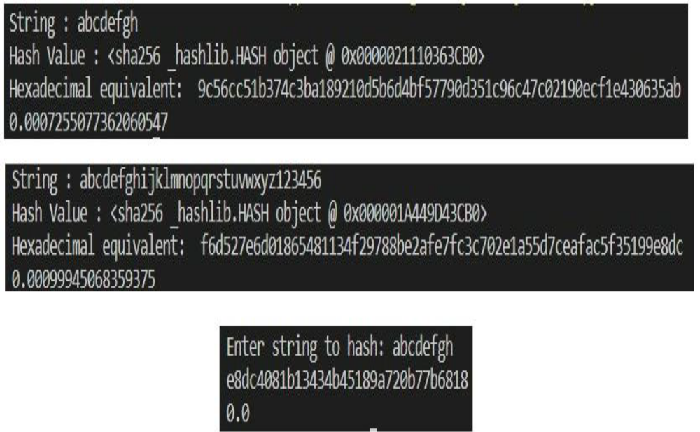
Detection of Counterfeit Goods Using Blockchain
Aman Kumar Pandey, Anand Singh, C. Sai Anand, Dheeraj Yadav Guide name: Dr. Amrendra Singh Yadav, VIT Bhopal
Project Group ID:- 15
ABSTRACT
INTRODUCTION
RESULTS
DISCUSSION
Counterfeit products are a serious problem in today's world, as it is not possible to distinguish between genuine products and counterfeit products. The anti-counterfeiting system that is being used are mostly centralized. Blockchain technology can be used guarantee the authenticity of the product to the user. Blockchain is a trending technology, and many applications use it. Blockchain technology is a technology in which information is stored in blocks in many databases connected to the chain and does not require the consent of a third-party user to gain access. The advantage of blockchain is that it is immutable and safe and decentralized. You can use a QR code (quick response) or a unique encrypted code. Scan the QR code or enter a unique code to go to the blockchain containing the product information and provide manufacturer details and owner information to help buyers decide whether to buy the product.
Fake products create a huge negative impact in the market for both buyers and sellers. Since the fake or counterfeit products are not restricted to any sector in the market therefore it has become important for us to detect these products and find a way to keep them out of the These products can be dangerous if we consider very dominating sectors of market like pharmaceutical and food. As we all know that no product is safe from counterfeiting due to the continuous growth in counterfeit products in the supply chain. It is degrading company’s name and their profit affecting the consumer.
Blockchain is a data storage system that makes it difficult or impossible to alter, hack, or defraud the system. A blockchain is a computerized record of transactions that is duplicated and disseminated across the blockchain's full network of PC computers. Each block in the chain comprises several transactions, and whenever a new transaction takes place on the blockchain, a record of that transaction is added to the records of all participants. Distributed Ledger Technology is a decentralized database that is administered by many people (DLT). Blockchain is a sort of distributed ledger technology in which transactions are recorded using a hash, which is an immutable cryptographic signature. Counterfeiting is a problem that blockchain technology helps to solve. It is more secure to use blockchain technology.
.
Cryptographic Algorithms
Three different algorithms are chosen – RSA, DES and AES. The corresponding results that are found are displayed. From the graph it becomes evident that AES outperforms the others making it the best in terms of memory utilization.
Hashing Algorithms
The graph proves that for a tiny chunk of data, there is no such difference in speed of the hashing algorithms but this changes when the size of the data set is increased, showing a sudden rise in the average time to hash of MD2. MD5 remains the best hashing algorithm in terms of speed.
The making of this prototype would require many small steps. The key idea is to use the advantages of blockchain and build up a good enough anti-counterfeiting application which deploys fast consensus algorithm, speed but secure hashing as well as cryptography.
The limitation of this prototype would be that it requires further work to be implemented successfully. This can be done by sticking to the modules and implementing them and carefully selecting the best hashing, cryptography as well as consensus algorithm so they the application can run smoothly and efficiently.
CONCLUSIONS
Blockchain technology is known for its security and anonymity, as well as the ease with which great information may be accessed thanks to its distributed network data processing. Blockchain has exploded in prominence in the financial world, and it falls under the fintech (finance and technology) umbrella. Because of its valuable characteristics, businesses have begun to adopt it at a rapid rate. Blockchain has been discovered to be an excellent tool for detecting bogus products and eliminating them from the supply chain or the retail sector. Users will be able to make better market decisions and trust the seller and manufacturer as a result of this. They won't have to rely on a third party to check the product's validity, making for a more pleasant and risk-free encounter. It will also assist manufacturing companies in being less concerned about counterfeit products on the market, allowing them to focus more on consumer input to improve their services. It would also help them avoid financial losses by allowing them to quickly track the goods they have launched on the market.
MODULES AND METHODS
The prototype is divided into 3 Modules:-
Manufacture Role: The manufacture can add the seller info, seller address to the block as well as get those details when required.
Seller Role: The seller can prove the authenticity of its ID, request for customer details and record them.
Customer Role: Customer can approve of his legitimacy. The Manufacture can verify customer info in case of any exchanges or defects which can be traced easily. It can also request for seller’s info for verification.
Chart 1. AES vs RSA vs DES.
Chart 2. Comparison of speed of different hashing algorithms
File Size | AES | DES | RSA
4.72 | 20316 | 14800 | 668
5.18 | 21592 | 13920 | 548
7.97 | 33020 | 13856 | 768
10.1 | 42068 | 21984 | 845
REFERENCES
1. Sidechain: storage land registry data using blockchain improve performance of search records Amrendra Singh Yadav, Nikita Singh, Dharmender Singh Kushwaha
2. Comparative Analysis of Cryptographic Algorithms in Securing Data Taylor Onate Egerton, Victor Emmah
Figure 1. Output of compilation time of SHA256
Table 1. Memory utilization values of AES, DES, RSA

